Slide 1
Battle of Neighborhoods
Seattle, Washington

Slide 2
Objective
Collecting Neighborhood’s top trending venues using Foursquare API(Beautiful Soup, http request)
Forming neighborhood clusters based on venue categories using unsupervised k-mean clustering algorithm(sklearn)
Identifying and understanding the similarities and dissimilarities between two chosen neighborhoods to retrieve more insights and to conclude with ease which neighborhood wins over other.

Slide 3
Python packages and Dependencies:
Pandas - Library for Data Analysis
NumPy – Library to handle data in a vectorized manner
JSON – Library to handle JSON files
Geopy – To retrieve Location Data
Requests – Library to handle http requests
Matplotlib – Python Plotting Module
Sklearn – Python machine learning Library
Folium – Map rendering Library

Slide 4
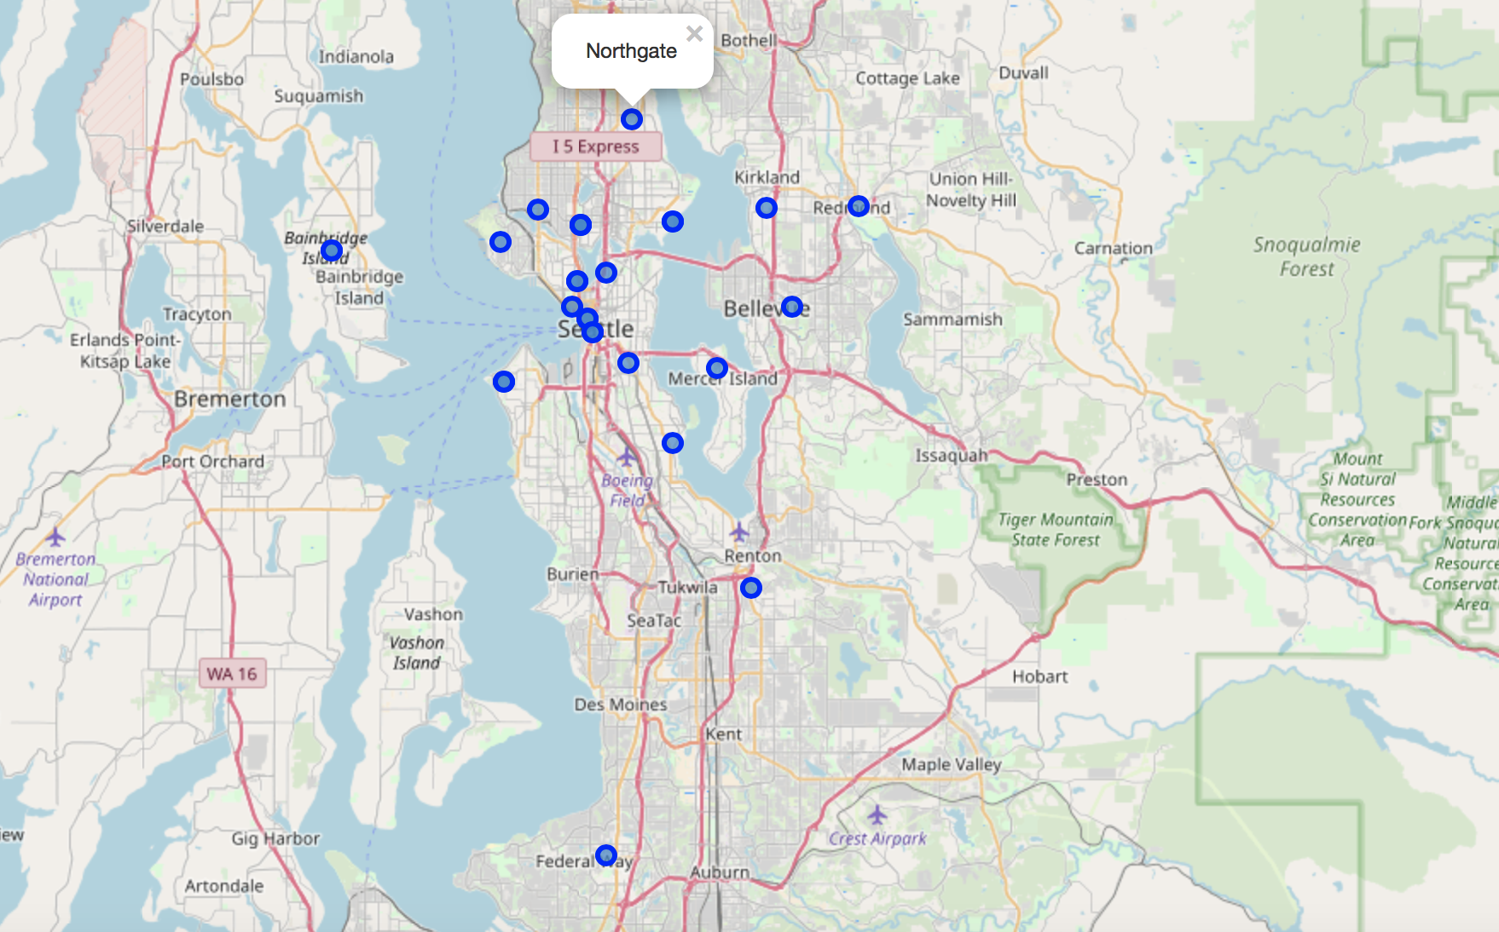
Neighborhood distribution – folium map

Slide 5
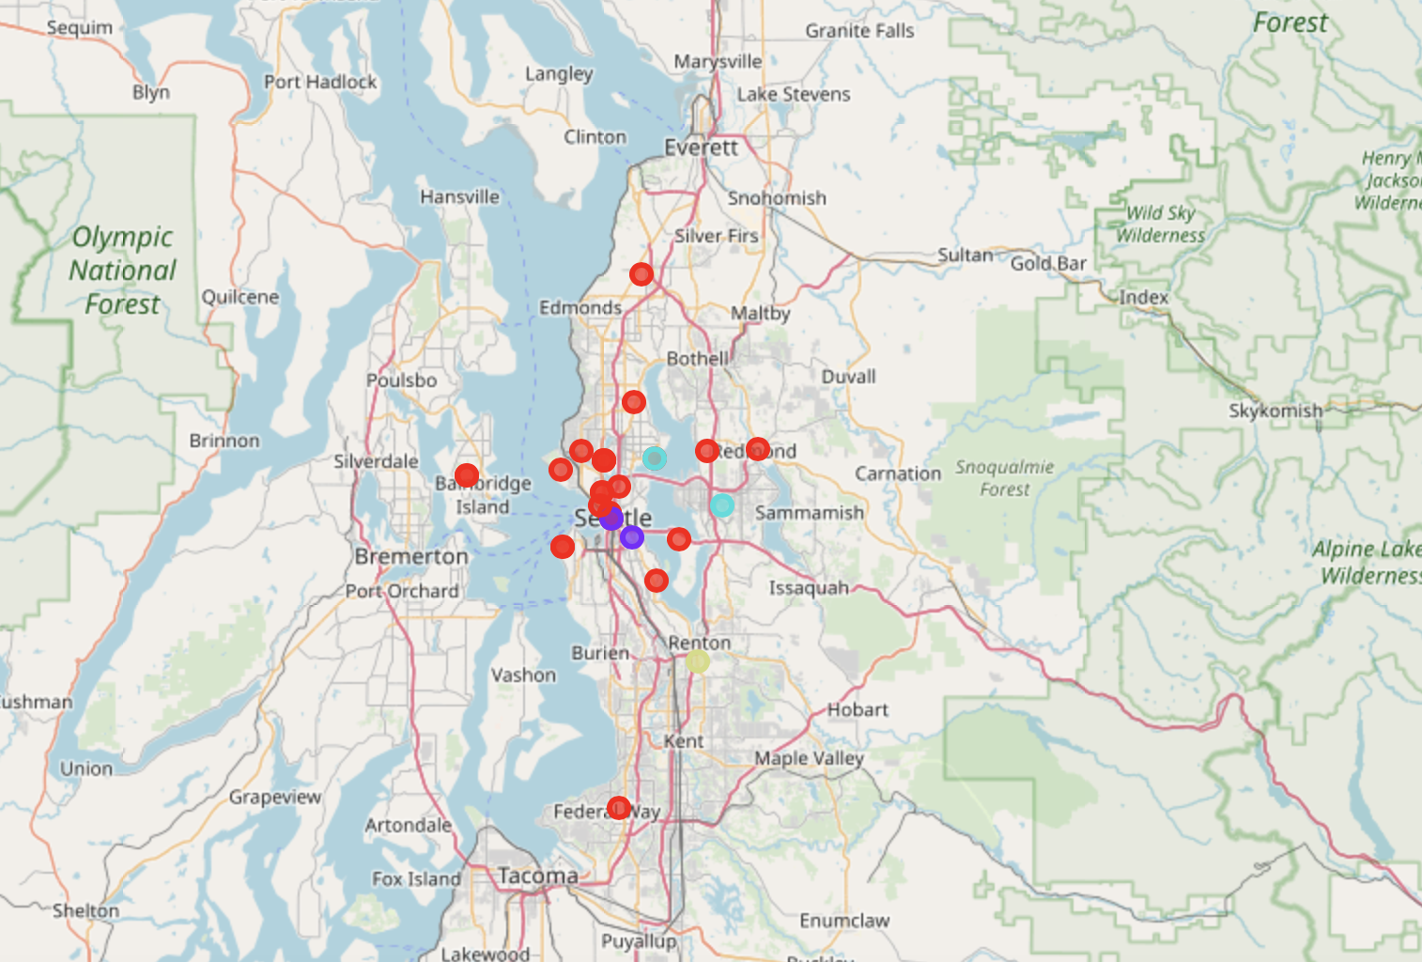
Neighborhood clusters

Slide 6
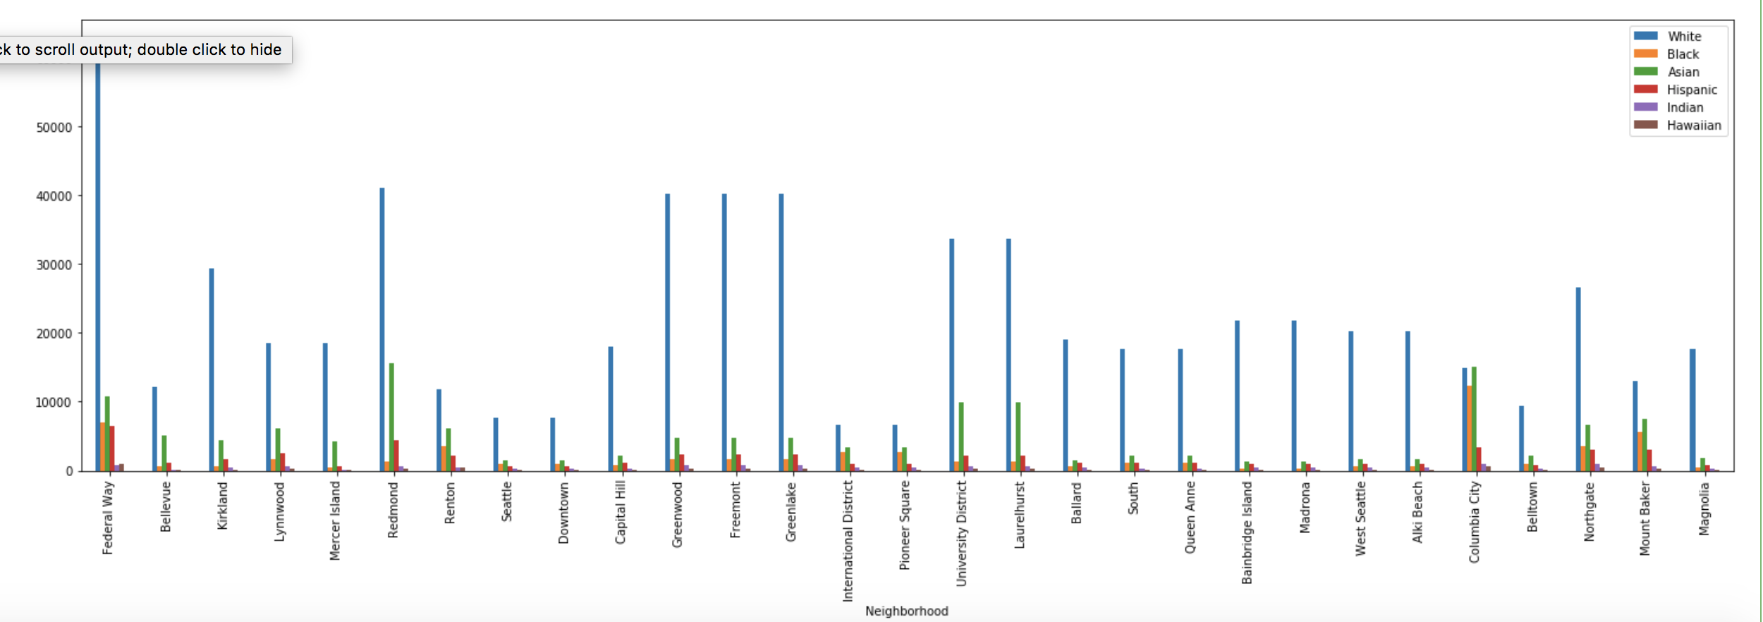
Population distribution

Slide 7
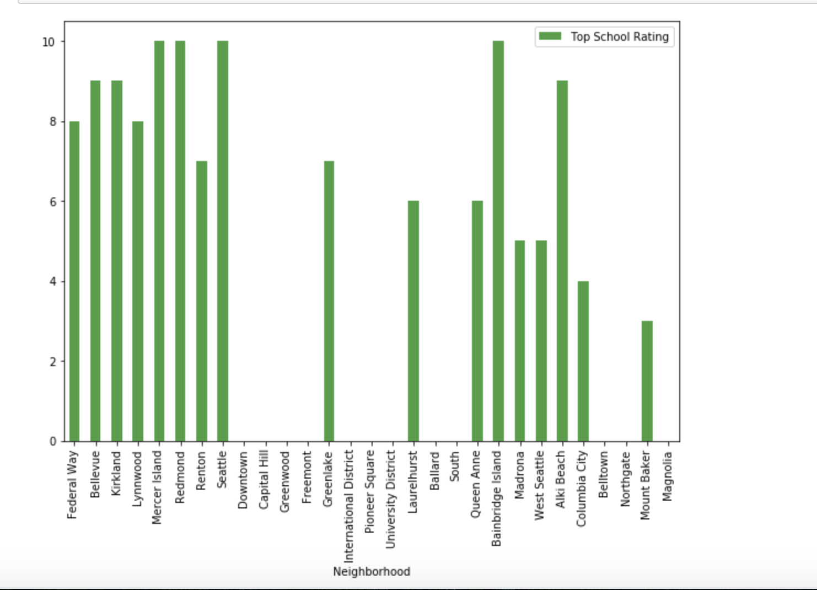
School ratings plot

Slide 8
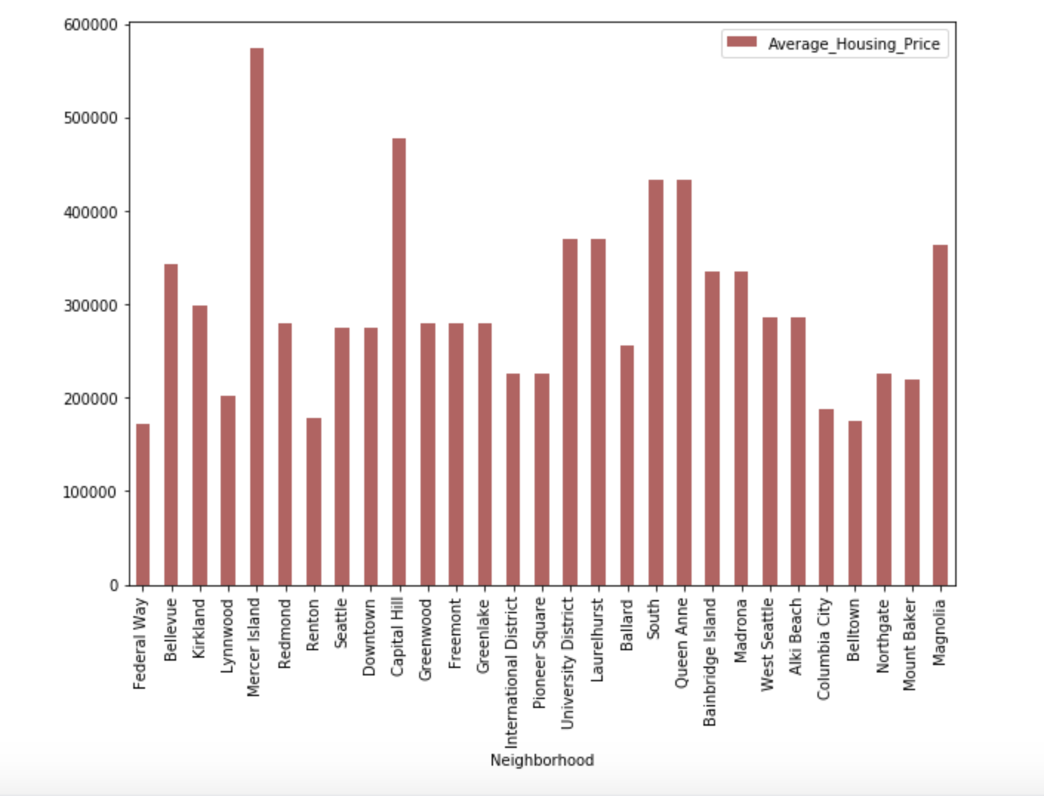
Average housing price plot

Slide 9
Comparison between Neighborhoods
Bellevue and Kirkland
Now lets compare 2 neighborhoods to choose one that best matches our requirements as given below
1. More Indian Population
2. Higher School Rating
3. Reasonable Housing Price in the Range of 300k to 500k
4. Comfortable Neighborhoods

Slide 10
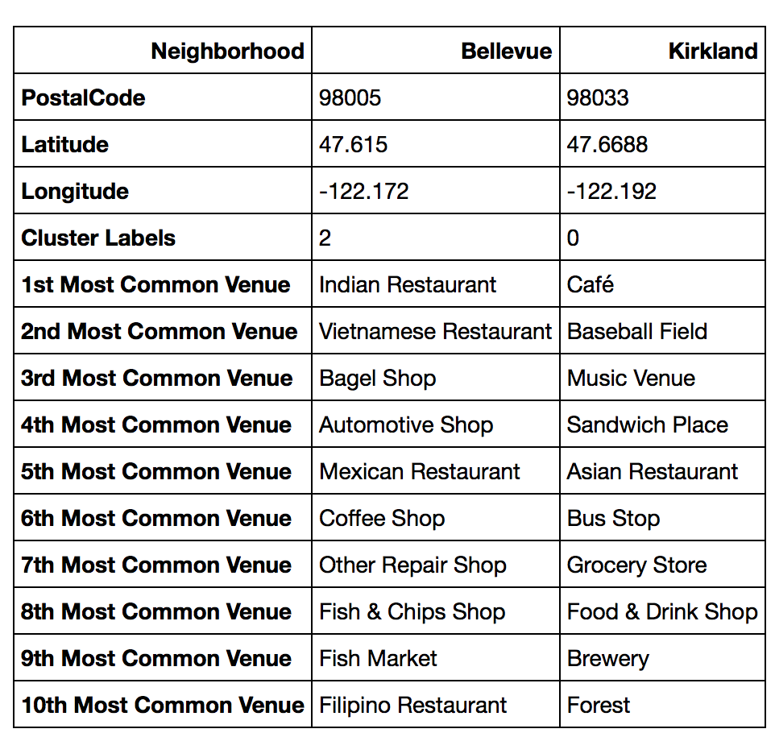
Neighborhood Venues

Slide 11
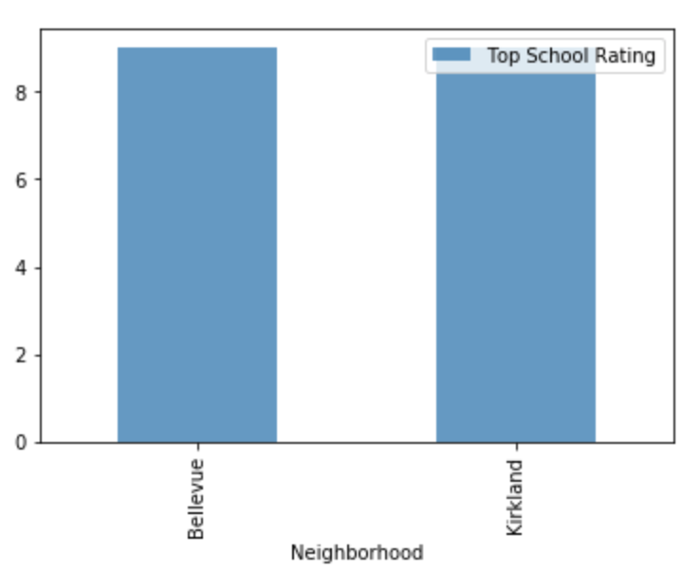
School ratings

Slide 12
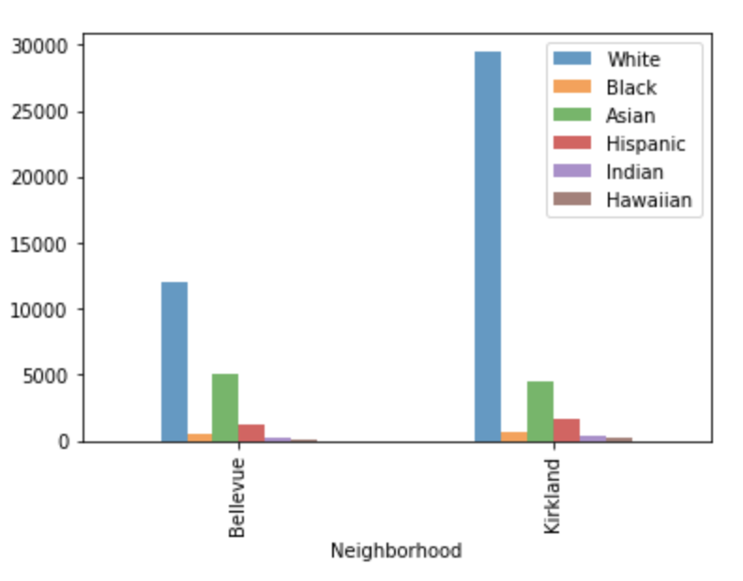
Population distribution

Slide 13
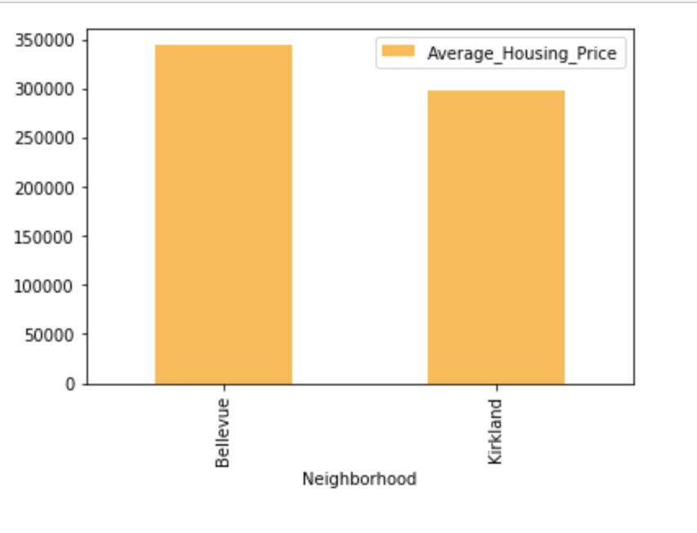
Average housing price

Slide 14
conclusion
This Analysis concludes that compared to Bellevue ,
Kirkland has the higher number of Indian population
Good school rating of 9
Reasonable average housing price of approximately 300k
Top 10 common venues shows Kirkland has gotten a good neighborhood with Cafe, Restaurants, Sandwich Place, Baseball Field etc.
Hence Kirkland wins over Bellevue!

Slide 15
Thank you

